Slide 1
Document Ranking System
Efficient Document Retrieval Using TF-IDF and Cosine Similarity Algorithms
Presented By: Ayesha Nadeem, 2021-CS-9

Slide 2
Agenda
01
02
03
04
05
06
Overview
Preprocessing
Gathering Documents
Ranking Algorithm
Part-of-Speech (POS) Tagging & Noun Extraction
Building an Inverted Index

Slide 3
01
Overview

Slide 4
Overview
Objective
To develop a search engine that ranks documents based on relevance to a user query using advanced techniques like TF-IDF and cosine similarity.
Why It's Needed
Traditional search engines only match keywords.
This approach prioritizes documents by relevance, improving the user experience.
TF-IDF & CosSim Calculation
User Query + Documents
Preprocessing
Indexing
Ranked Documents

Slide 5
Overview
Why It's Needed
Scenario
A student searches for notes on "machine learning basics" in a folder of class material.
Without TF-IDF or Cosine Similarity
Matches all documents with "machine" or "learning," even if they’re irrelevant.
With TF-IDF or Cosine Similarity
Ranks documents based on how often "machine learning basics" appears and how rare these terms are in the collection.

Slide 6
Overview
Key Differences - Traditional vs TF-IDF Search Engines
Feature | Traditional Search | TF-IDF with Cosine Similarity
Keyword Matching | Exact matches only | Weighs term importance (TF-IDF)
Ranking | No ranking | Ranked by relevance
Relevance | Often imprecise | Highly precise

Slide 7
02
Gathering Documents

Slide 8
Gathering Documents
Purpose
Collects all .txt files from a specified folder path
Reads each file’s contents to create a dataset that can be used by other parts of the program.
Process
Opens each text file, reads content, and stores it in a list of dictionaries with title and content

Slide 9
03
Preprocessing

Slide 10
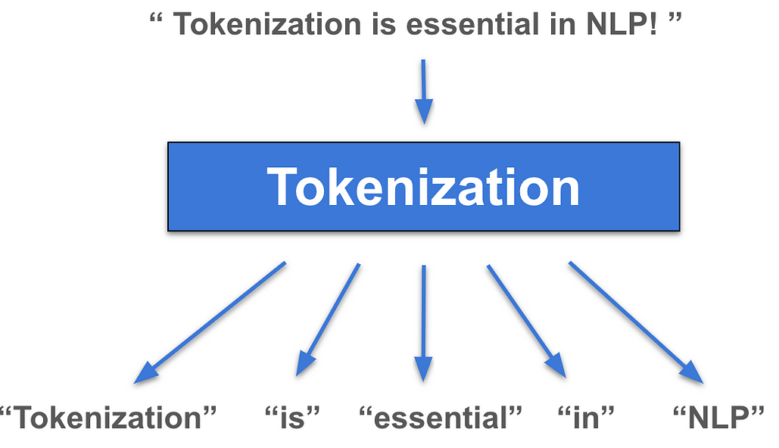
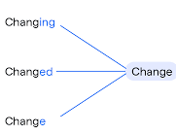
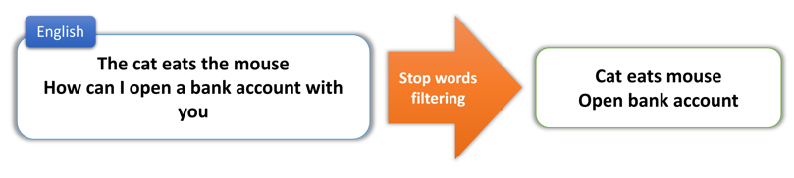
Preprocessing
Purpose
Prepares raw text for analysis by cleaning and structuring it.
To simplify the text and remove noise for further processing
Steps Involved
Tokenization
2. Lemmatization
3. Stop Words Removal

Slide 11
04
Part-of-Speech (POS) Tagging & Noun Extraction

Slide 12
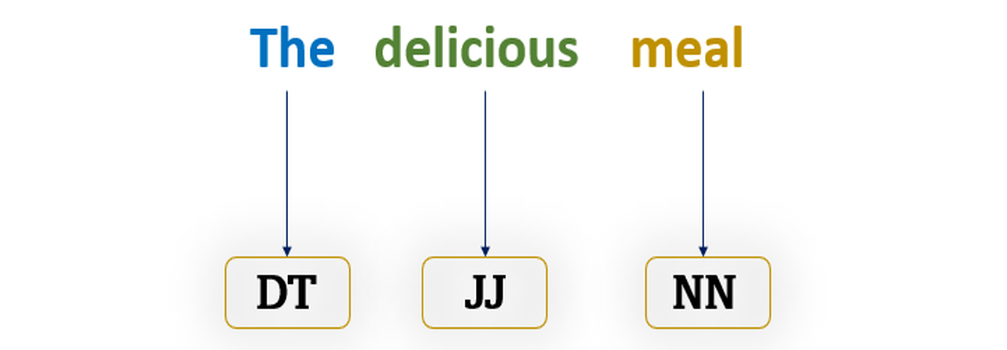
Part-of-Speech (POS) Tagging
Purpose
Assigns grammatical roles (like noun, verb, etc.) to each word.
Helps in filtering and focusing on specific types of words for search indexing.

Slide 13
Noun Extraction
Purpose
Identify and extract nouns from text as they represent core subjects or topics.
Why Nouns?
Nouns usually denote key concepts, themes, or entities in the text, such as people, places, or objects.
By focusing on nouns, the search engine indexes terms most likely to reflect document topics.

Slide 14
05
Building an Inverted Index

Slide 15
Building an Inverted Index
Purpose
Special noun acts as an index entry that maps to documents, making searches faster and reducing the need to scan entire texts repeatedly
How it works
For each document, splits content by paragraphs and extracts special nouns
Counts each noun’s occurrences in the document. Only nouns appearing more than once are recorded to emphasize key topics.
Adds nouns to an inverted_index dictionary, where keys are nouns, and values are dictionaries of document titles with count frequencies

Slide 16
06
Ranking Algorithms

Slide 17


Term Frequency-Inverse Document Frequency (TF-IDF)
Purpose
Identifies the importance of a term in a document relative to the entire collection.
TF
Frequency of the term in the document
IDF
Importance of the term in all documents

Slide 18
Term Frequency-Inverse Document Frequency (TF-IDF) - Computed Example
Folder Contents:
Document 1: "Apples are tasty fruits."
Document 2: "Bananas and apples are fruits."
Document 3: "Apples and bananas are good for health."
Query: "apples"
Calculate Term Frequency (TF) TF = (Term Count in Document) ÷ (Total Terms in Document)
For "apples":
Document 1: TF = 1 ÷ 3 = 0.33
Processed Documents:
Document 1: ["apples", "tasty", "fruits"]
Document 2: ["bananas", "apples", "fruits"]
Document 3: ["apples", "bananas", "good", "health"]
Document 2: TF = 1 ÷ 3 = 0.33
Document 3: TF = 1 ÷ 4 = 0.25

Slide 19
Term Frequency-Inverse Document Frequency (TF-IDF) - Computed Example
Ranked Results:
Document 1: TF-IDF = 0.33
Document 2: TF-IDF = 0.33
Document 3: TF-IDF = 0.25

Slide 20
Cosine Similarity
Purpose
To measure the similarity between two data vectors, regardless of their magnitude. It focuses only on the direction of the vectors, not their size or length.
Vector Representation
The query and each document are represented as vectors, where:
Each dimension corresponds to a unique term.
Term weights in the vector are derived from TF-IDF scores.
If the vectors point in the same direction, the cosine similarity is 1 (maximum similarity).
If they are orthogonal (at 90 degrees), the cosine similarity is 0, indicating no similarity.

Slide 21

Cosine Similarity
Purpose
To measure the similarity between two data vectors, regardless of their magnitude. It focuses only on the direction of the vectors, not their size or length.
Dot Product
Magnitude

Slide 22
Cosine Similarity - Computed Example
Folder Contents:
Document 1: "Apples are tasty fruits."
Document 2: "Bananas and apples are fruits."
Document 3: "Apples and bananas are good for health."
Query: "apples"
Processed Documents:
Document 1: ["apples", "tasty", "fruits"]
Document 2: ["bananas", "apples", "fruits"]
Document 3: ["apples", "bananas", "good", "health"]

Slide 23
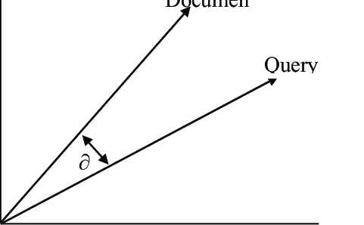
Cosine Similarity - Computed Example
Vectorize Documents and Query Vocabulary: ["apples", "tasty", "fruits", "bananas", "good", "health"]
Query Vector:
Apples = 1, All other terms = 0 Query Vector = [1, 0, 0, 0, 0, 0]
Document Vectors:
Document 1: [1, 1, 1, 0, 0, 0] (apples, tasty, fruits)
Document 2: [1, 0, 1, 1, 0, 0] (apples, fruits, bananas)
Document 3: [1, 0, 0, 1, 1, 1] (apples, bananas, good, health)

Slide 24
Cosine Similarity - Computed Example
Compute Cosine Similarity
Document 1 vs Query:
Dot Product: (1×1) + (0×1) + (0×1) = 1
Magnitude of Query: (1² + 0² + 0² + 0² + 0² + 0²) = 1
Magnitude of Document 1: (1² + 1² + 1² + 0² + 0² + 0²) = 3
Cosine Similarity:
Cosine Similarity = 1 / (1 * 3) = 1 / 3 ≈ 0.333

Slide 25
Cosine Similarity - Computed Example
Compute Cosine Similarity
Document 2 vs Query:
Dot Product: (1×1) + (0×0) + (1×0) = 1
Magnitude of Query: 1
Magnitude of Document 2: (1² + 0² + 1² + 1² + 0² + 0²) = 3
Cosine Similarity:
Cosine Similarity = 1 / (1 * 3) = 1 / 3 ≈ 0.333

Slide 26
Cosine Similarity - Computed Example
Compute Cosine Similarity
Document 3 vs Query:
Dot Product: (1×1) + (0×0) + (0×0) = 1
Magnitude of Query: 1
Magnitude of Document 3: (1² + 0² + 0² + 1² + 1² + 1²) = 3
Cosine Similarity:
Cosine Similarity = 1 / (1 * 3) = 1 / 3 ≈ 0.333

Slide 27
Thank You

